Slide 1
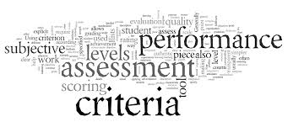
Creating and Using Rubrics

Slide 2
Learning Target:
I can create a best practice rubric using parallel, unambiguous criteria that will facilitate the learning process, provide meaningful feedback, and measure student performance in an effective and efficient manner.

Slide 3
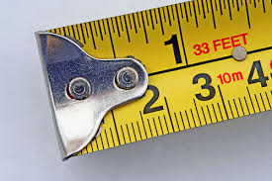
What is a Rubric?
Measurement Tool
Set of guidelines for critical elements
Guides analysis of student work
Uses clear performance criteria
Defines the quality expectations
Purpose – provide feedback & structure for learning, planning, instruction, and assessment
Notes:
A rubric is a criterion-referenced tool. (Norm-referenced compares one individual’s performance to another’s performance.)
“Did student meet the criteria for level X of the rubric?” rather than “How well did this student do compared to other students?”

Slide 4
Definition:
A rubric defines the features of work that constitute quality. It is the mechanism for judging the quality of student work (Arter & Chappuis, 2007).
A rubric is a measurement tool that describes the criteria against which a performance, behavior, or product is compared and measured (Brophy, 2012).
Notes:
Shap-pwee – nationally recognized expert on formative assessment; Vice President of Pearson Assessment Training Institute
Timothy Brophy –Professor of Institutional Assessment at Ohio State

Slide 5
“Rubrics provide the vocabulary and illustrations needed to communicate with our students about the path to successful performance” (Stiggins & Chappuis, 2012). Rick’s website: http://www.rickstiggins.com/
Notes:
Shap-pwee
Rick Stiggins – founder of Assessment Training Institute (ATI)

Slide 6
Effective Rubrics
Can help students
Can help teachers
Understand what is wanted on an assignment.
Understand what quality looks like.
Understand what was and wasn’t done well.
Self-assess work.
Plan instruction.
Grade consistently.
Have sound justifications for grades.
Provide students with communication clarity & fluent feedback.
Notes:
Helps both teachers and students
Grade consistently = reliability
Aligned to standards = validity (measure what it purports to measure)

Slide 7
Two Major Types of Rubrics
Holistic Rubrics
Analytic Rubrics
One global score
Single descriptive scale
Supports broader judgments of quality
Views product/behavior/performance as a whole
Separate scores
Separate facets are defined, valued, and scored
Each scored on separate descriptive scale
Allows for weighting of factors
Notes:
Performance/behavior/product broken down into its component parts, evaluating and rating each part.

Slide 8
 | Advantages | Disadvantages | Use when:
Analytic | More detailed feedback Scoring more consistent | Time consuming to create and apply | Want to see strengths/weaknesses Want detailed feedback
Holistic | Quick scoring Less time to create | Does not provide detailed feedback | Want quick snapshot of achievement Single dimension is adequate to define quality
Notes:
Holistic provides an overview of achievement

Slide 9
Example Holistic Rubric (Fiction-Writing)
5 | The plot, setting, and characters are developed fully and organized well. The who, what, where, when, and why are explained using interesting language and sufficient detail.
4 | Most parts of the story mentioned in a score of 5 above are developed and organized well. A couple of aspects may need to be more fully or more interestingly developed.
3 | Some aspects of the story are developed and organized well, but not as much detail or organization is expressed as in a score of 4.
2 | A few parts of the story are developed somewhat. Organization and language usage need improvement.
1 | Parts of the story are addressed without attention to detail or organization.
VAGUE
Notes:
Here: Plot, setting, and character are combined.

Slide 10
Example Analytic Rubric (Fiction-Writing)
Criteria | Excellent (94-100%) | On-Track (86-93%) | Emerging (76-85%) | Off-Track (<76%)
PLOT: What & Why | Both plot parts (what and why) are fully developed with much descriptive detail. | One of the plot parts is fully developed and The less developed part is at least addressed. | Both plot parts are addressed but Not fully developed. | Neither plot parts are fully developed.
SETTING: When & Where | Both setting parts are fully developed with much descriptive detail. | One of the setting parts is fully developed and The less developed part is at least addressed. | Both setting parts of the story are addressed but Not fully developed. | Neither setting parts are developed.
CHARACTERS Who Described by behavior, appearance, personality, and character traits. | The main characters are fully developed with much descriptive detail. The reader has a vivid image of the characters. | The main characters are developed with Some descriptive detail. The reader has a vague idea of the characters. | The main characters are identified by name only. | None of the characters are developed or named.
Notes:
Here: plot, setting, character are separated

Slide 11
#1 Guideline for Constructing Effective Rubrics:
Avoid Ambiguous Vocabulary
No Confusion
Concrete vs. Abstract
Irrefutable
Notes:
MOST COMMON CHALLENGE!!!
Avoid vague words such as interesting, organized, well done, creative, imaginative, sufficient, great, okay….

Slide 12
Concrete vs. Abstract
Key question to ask yourself:
What does it look like?
Organized:
Sharply focused thesis, topic sentences clearly connected to thesis, logical ordering of paragraphs, conclusion ends with clincher.

Slide 13
Elusive terms
Discuss what the term looks like
For example, what does “creative beginning” mean for a speech?
List ways the elusive term can be met
Notes:
Instead of saying “creative beginning,” this rubric creator listed creative ways:
“Gives details or an amusing fact, a series of questions, a short demonstration, a colorful visual, or a personal reason why topic was picked.

Slide 14
Guideline #2:
Define quality with clarity and precision.
Gradations of quality
Highest performance on LEFT!
Clear language
Low reading level
Notes:
1. What “counts” for quality work
2. Articulate gradations of quality: describe the best, worst, and then fill in the middle levels - but keep them parallel (next slide)
3. Aim for lowest reading level
4. Performance indicators should be arranged so that the Highest Performance is right up next to the criteria…student sees the criteria and then sees what an excellence performance indicator looks like for that criteria.
5. Lowest score should describe what novice performance/product looks like – not “bad”

Slide 15
Guideline #3:
Criteria should be:
Measureable
specify quality versus comparatives (“not as thorough as”) value language (“excellent content”)
Independent
Don’t combine: “clarity” & “organization”
Limited in Number
Notes:
Don’t combine independent criteria (For example: “clarity” and “organization” -- something can be clear but not organized and vice versa.)
Measureable = specify what quality (or absence of quality) looks like versus comparatives (“not as thorough as”) or value language (“excellent content”)

Slide 16
Guideline #4:
Be concise &
focus on the positive
Notes:
Avoid wordiness and unnecessarily negative language
Behavior Rubric: Good – Not So Good – Just Awful
If a zero is used at all, it should state “ not enough evidence at this point to assess understanding” ---sends the message that performance can be improved.

Slide 17
Guideline #5:
Criteria/Benchmark Alignment
Notes:
What criteria will satisfy or exemplify this benchmark?
1. Analyze is the key verb….so it must be addressed in the criteria.
2. Interconnectedness of environment and human activities
3. Impact
4. Technology

Slide 18
Guideline #6:
Gather examples that exemplify the quality levels.
Models the different performance levels
What makes the “good one good” and the “better one better”
Exemplars of top quality.
Notes:
Examples amplify the learning leverage of rubrics because they concretely and visually demonstrate the gradations of quality –what makes the good one good and the poor one poor?
Samples help student “see” the quality

Slide 19
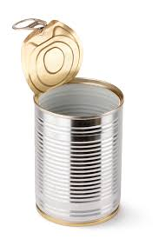
Guideline #7:
Caution:
Generic or “Canned” Rubrics
Carefully consider their quality and appropriateness for your standards, goals, learning targets, instruction, students, etc.
Notes:
Your students have received your instruction.

Slide 20
Guideline #8:
Involve Students in Rubrics
Student Self-Assessments and Peer Assessments
Assess own progress and make improvements accordingly
Include students in creating rubrics
Consider using the “I” descriptors
“I consistently followed MLA documentation format.”
When do you give the rubric to your students?
Notes:
Ask students to self-assess their own progress using the rubric AND MAKE IMPROVEMENTS ACCORDINGLY.

Slide 21
Guideline #9:
Performance Levels
Define poles and work inward
Create continuum between least and most
Parallel descriptions
List skills/traits/outcome expectations consistently across levels
Aim for even number -
4 to 6 recommended (Brophy recommends 4)
Requires a decision between “almost there” and “bare bones”
Notes:
Lowest score should describe what novice performance/product looks like – not “bad”

Slide 22
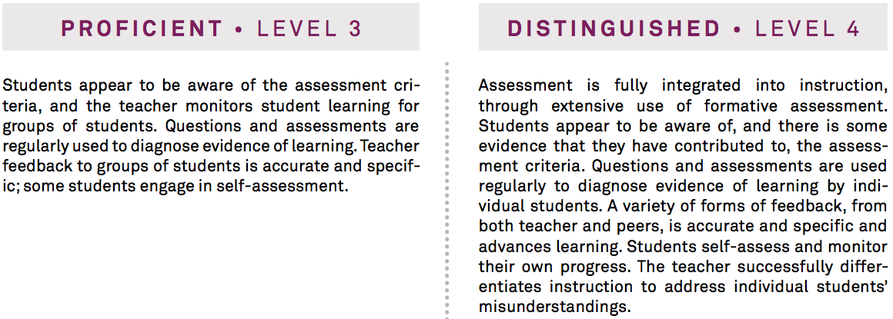
Charlotte 3D: Using Assessment in Instruction
Notes:
Unsatisfactory = students not aware of assessment criteria; little/no monitoring of student learning; feedback is poor/absent; no self/peer assessment
Basic = students partially aware of assessment criteria; monitor student learning for class as a whole; questions/assessments rarely used to diagnose evidence of learning; feedback is general; few students assess own work
Proficient = students appear aware of assessment criteria; monitors student learning for groups of students; questions/assessments regularly used; feedback to groups accurate and specific; some students self-assess
Distinguished = assessment fully integrated & extensive use of formative assessment; students aware (and contributed to?) assessment criteria; questions/assessments used regularly by individual students; variety of forms of feedback advances learning; students self-assess and monitor own progress; teacher successfully differentiates instruction to address individual students’ misunderstandings.

Slide 23
 | Unsatis. | Basic | Proficient | Distinguished
Assessment Criteria | Students not aware | Partially aware | Aware | Aware and contribute
Ques./assess to diagnose learning |  | Rarely used | Regularly used | Regularly used
Monitor learning | Little/no | Class as whole | Groups of students | Students monitor own progress
feedback | Poor/absent | General | Accurate/specific | Variety & advances learning
Students self-assess | no | few | some | Self-assess
 |  |  |  | Extensive formatives
 |  |  |  | Successful differentiation

Slide 24
Creating a Rubric (Oral Presentation) (Assigning Weighted Values to Levels of Performance Using Points)
Criteria | Exemplary | Satisfactory | Below Expectations | Score
Organization | (7-8 pts.) | (5-6 pts.) | (0-4 pts.)
Content | (12-13 pts.) | (9-11 pts.) | (0-8 pts.)
Delivery | (8-9 pts.) | (6-7 pts.) | (0-5 pts.)
Total Points |  |  |  | ___/30
Notes:
Weighted values in the levels of performance with points

Slide 25
Creating a Rubric (Oral Presentation) (Assigning Weighted Values to Levels of Performance Using Percents)
Criteria | Exemplary (92-100%) | Satisfactory (83-91 %) | Below Expectations (<83%) | Score
Organization (30 pts.)
Content (30 pts.)
Delivery (40 pts.)
Total Points |  |  |  | __/100
Notes:
Weighted criteria and levels of performance with points/percentages

Slide 26
Oral Presentation Rubric
Criteria | Exemplary (92-100%) | Satisfactory (83-91%) | Below Expectation (<83%) | Score
Organization 30 Pts. | Presentation is carefully organized and Provides convincing evidence to support conclusions. | Presentation has a focus and Provides some evidence which supports conclusions. | No apparent organization. Evidence is not used to support assertions.
Content 30 Pts. | Content is accurate and complete. Listeners are likely to gain new insights about the topic. | Content is generally accurate, but incomplete. Listeners may learn some isolated facts, but they are unlikely to gain new insights about the topic. | Content is inaccurate or overly general. Listeners are unlikely to learn anything or may be misled.
Delivery 40 Pts. | Speaker is relaxed and comfortable. Speaks without undue reliance on notes. Interacts effectively with listeners. | Speaker is generally relaxed and comfortable. Too often relies on notes. Listeners are sometimes ignored or misunderstood. | Speaker appears anxious and uncomfortable. Reads from notes. Listeners are largely ignored.
Total Points |  |  |  | 2

Slide 27
Sample 1 (Points, no weighting)
Project Criteria | Exceeds Expectation 6 points each | Meets Expectations 5 points each | Does Not Meet Expectations 3 point each
Design | Symmetry of design shows creativity More than two colors that complement each other Poster is appealing and easy to read | Design illustrates symmetry More than two colors were used in the design Poster is neat and easily readable | Design illustrates little or no symmetry Two or fewer colors were used in the design Poster lacks neatness or may not be easy to read
Content | Pony Penning Day theme is clear and unique/creative All major events identified, readable, and creatively displayed All times and places are identified, easily readable, and creatively displayed | Pony Penning Day is clear theme of poster All major events are identified and easily readable All times and places are identified and easily readable | Pony Penning Day theme is not apparent Major events may be missing and/or not easily readable Times and/or places may be missing or not easily readable

Slide 28
Sample 2 (Weighting Using Points)
Project Criteria | Exceeds Expectation | Meets Expectations | Does Not Meet Expectations
Design | Symmetry of design shows creativity More than two colors that complement each other Poster is appealing and easy to read (4 points each) | Design illustrates symmetry More than two colors were used in the design Poster is neat and easily readable (3 points each) | Design illustrates little or no symmetry Two or fewer colors were used in the design Poster lacks neatness or may not be easy to read (2 point each)
Content | Pony Penning Day theme is clear and unique/creative All major events identified, readable, and creatively displayed All times and places are identified, easily readable, and creatively displayed (6 points each) | Pony Penning Day is clear theme of poster All major events are identified and easily readable All times and places are identified and easily readable (4.5 points each) | Pony Penning Day theme is not apparent Major events may be missing and/or not easily readable Times and/or places may be missing or not easily readable (3 points each)

Slide 29
Brophy’s Rubric Development Guide
Step 1: Determine rubric type – holistic or analytic.
Step 2: Identify the criteria to be rated
Rows
These are the quality indicators
Characteristics or specific skills, knowledge, and/or behaviors that you will be looking for.
Limit to those that are most important to the assessment

Slide 30
Brophy rubric dev. continued:
Step 3: Determine scoring levels
Proficiency indicators
What is the range of performance?
Columns
Highest level – on the left to see it first!!!
Brophy recommends four levels
Step 4: Write proficiency descriptors for each level of rubric
Start at highest level = This is “success” level
“work in” from the “poles”
Keep each level parallel
Notes:
Parallel = each detail mentioned in all performance levels

Slide 31
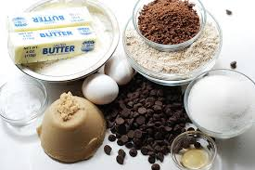
The Cookie
Task:
Create a chocolate chip cookie that I would want to eat.
Notes:
This is the standard.

Slide 32
What might be the criteria for this award-winning cookie?
Notes:
Texture, taste, number of chocolate chips, richness

Slide 33
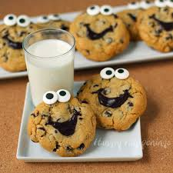
What might be the performance levels?
Notes:
Delicious, Tasty, Edible, Not Yet Edible

Slide 34
The Cookie Rubric
 | Delicious 4 | Tasty 3 | Edible 2 | Not Yet Edible 1
# Chips
Texture
Color
Richness

Slide 35
The Cookie Rubric
 | Delicious 4 | Tasty 3 | Edible 2 | Not Yet Edible 1
# Chips | Chips in every bite | 75% chips | 50% chips | Less than 50% chips
Texture | Consistently chewy throughout;10% moisture | Chewy middle & crisp edges; 8% moisture | Crunchy; moisture below 3% | Like a biscuit; 0% moisture
Color | Even golden brown | Golden brown with pale center | All brown or all pale | Burned or raw
Richness | Buttery, high fat | Medium fat | Low-fat flavor | Nonfat flavor

Slide 36
Evaluating Rubrics
Criteria
# of criteria appropriate for complexity of task
measureable
Alignment to Standards/Learning Targets/Goals
Performance Level
“Excellence” level adjacent to criteria
Can students see what features define strong, medium, weak?
Clarity
Vague language/vocabulary?
Positive?
Performance levels well defined?
Are quality descriptions parallel across levels?
Notes:
Content:
Content represent best thinking about what it means to perform well?
Content on rubric align with learning targets?
Criteria:
Is number of criteria appropriate for complexity of task?
Are descriptors organized well?
Does relative emphasis represent relative importance?
Is contribution of criterion clear?
Levels Defined
Features of quality work well defined?
Levels Parallel
Parallel language across performance levels?

Slide 37
Weebly Website
lpmentoring.weebly.com

Slide 38
Some Rubric Resources:
http://rubistar.4teachers.org/index.php
http://www.teach-nology.com/web_tools/rubrics/
http://fcit.usf.edu/assessment/performance/assess
http://rubrics4teachers.com/archive.php
http://www.rcampus.com/indexrubric.cfm
http://www.teacherjet.com/rubrics.html

Slide 39
Formative Assessment
Let’s Kahoot!
Go to kahoot.it and enter the game PIN

