Slide 1
Building Unity and Collaboration Among General and Special Educators
Special Education Boot Camp for School Administrators
Session 1 of 9

Slide 2
FOUR Common Themes
TRUST
COLLECTIVE RESPONSIBILITY
INTENTIONAL COLLABORATION
ASSESSMENT & DATA

Slide 3
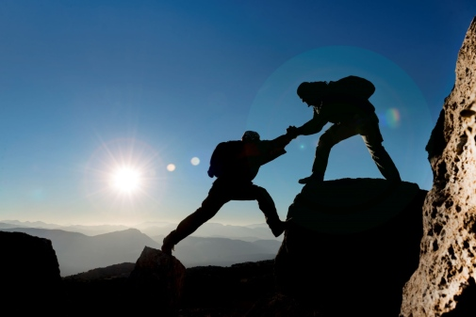
Trust
In order for there to be successful collaboration among general and special educators, all parties MUST
honor each other’s strengths and needs
ask one another for help when needed
communicate respectfully and honestly to one another
understand each other’s perspectives
observe one another and offer constructive feedback
provide moral support to one another
trust and honor each other’s professional experiences

Slide 4
Collective Responsibility
The VISION of the school must be centered around the idea of inclusion; all students are all our students.
All teachers need support from the building principal
Special Education Teachers specialize in making the content accessible to a variety of learners
General Education Teachers specialize in the content itself
The principal must have high expectations for participation at IEP from all members of the IEP team

Slide 5
Intentional Collaboration
Collaboration time needs to be scheduled and intentional
Effective collaboration behaviors include: sharing ideas, active listening, questioning, planning, problem solving, and negotiating
Together special and general educators must coordinate expectations, responsibilities, and resources
Allow opportunities to co-teach; remember there has to be co-planning in order to effectively co-teach
Provide opportunities for general and special educators to attend professional development together
Cooperatively plan accommodations and modifications for students on IEPs

Slide 6
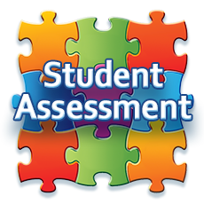
Assessment and Data
Diagnostic, formative, and summative assessments should be given to ALL students.
Together, general and special educators should examine the assessment data of ALL students.
They should then use that data to guide instructional decisions for ALL students.

Slide 7
References
“9 Tips to Help Special Education Teachers and Classroom Teachers Collaborate.” Free Spirit Publishing Blog, 6 Apr. 2016, freespiritpublishingblog.com/2016/04/07/9-tips-to-help-special-education-teachers-and-classroom-teachers-collaborate/.
Ascd. When Special and General Educators Collaborate, Everybody Wins, www.ascd.org/ascd-express/vol14/num25/when-special-and-general-educators-collaborate-everybody-wins.aspx.
Grafwallner, Peg. “What I've Learned From Special Ed Teachers.” Edutopia, George Lucas Educational Foundation, 19 Dec. 2017, www.edutopia.org/article/what-ive-learned-special-ed-teachers.
McLeskey, James. High-Leverage Practices in Special Education. Council for Exceptional Children, 2017.
TeacherReady. “Collaborate with Special Education Teachers.” TeacherReady, TeacherReady, 16 Aug. 2017, www.teacherready.org/collaborate-with-special-education-teachers/.
“Top 10 Ideas for Collaboration.” Don Johnston, 5 Sept. 2019, learningtools.donjohnston.com/2013/01/top-10-ideas-for-collaboration/.
“What Are the First Steps That Ms. Flores, the School Principal, and the School Improvement Team Should Take to Support Students with Disabilities throughout the School System?” IRIS Center, iris.peabody.vanderbilt.edu/module/esp/cresource/q1/p03/.

